Slide 1
Robot Mapping with Proprioceptive Spatial Awareness in Confined and Sensor-Challenged Environments
Jacob Everist
Advisor: Wei-Min Shen
Committee: Ramakant Nevatia
Committee: Behrokh Khoshnevis

Slide 2
Outline
Problem
Related Work
Approach
sensing, features, control, robot frame, mapping
Results
Conclusion

Slide 3
Problem
Environments that are sensor-challenged and confined are difficult to robotically explore and map
Pipes
Caves
External sensors such as cameras, sonar, and LIDAR may be become inoperable due to damage, occlusions, lighting and fluid conditions

Slide 4
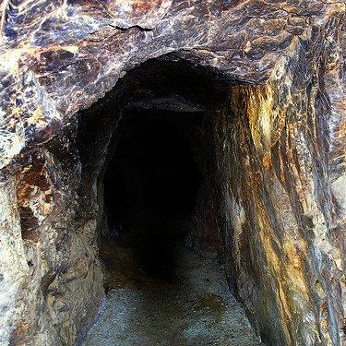
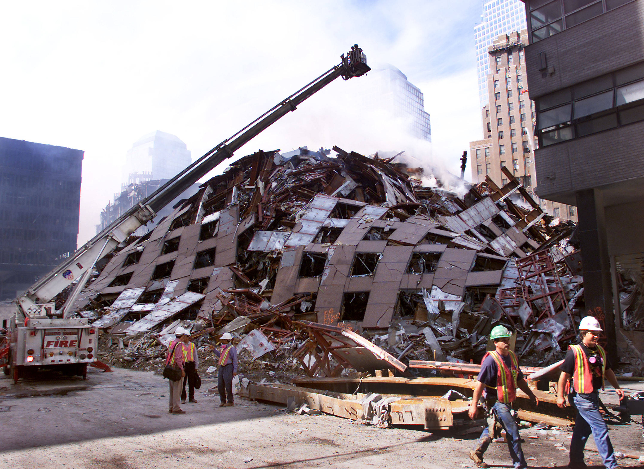
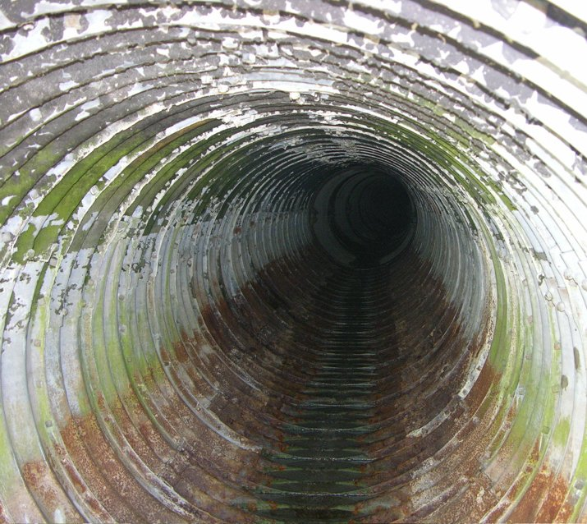
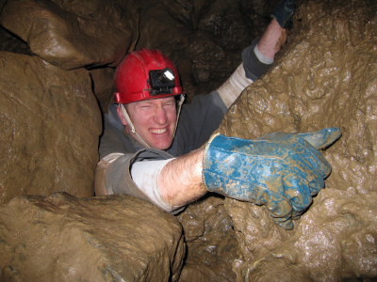
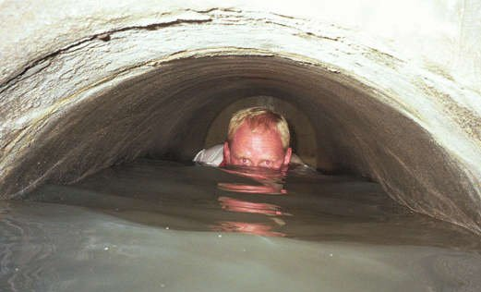
Environments

Slide 5
Motivation
Allow mapping and exploration of previously inaccessible environments
Flooded mines and caves (cave exploration, geology)
Pipes and sewers (pipe inspection)
Debris piles (search and rescue)
Seek solution invariant to ambient fluids (air, transparent liquid, opaque liquid)

Slide 6
Mining Disasters
West Virginia, 29 dead, 2010
Utah, 9 dead, 2007
West Virginia, 12 dead, 2006
Kentucky, 5 dead, 2006
Alabama, 13 dead, 2001

Slide 7
Earthquakes
Haiti, 222570 dead, 2010
Sumatra, 1117 dead, 2009
Sichuan, 87587 dead, 2008
Peru, 514 dead, 2007
Java, 5749 dead, 2006
Pakistan, 80361 dead, 2005
Sumatra, 227898 dead, 2004
Iran, 31000 dead, 2003

Slide 8
Cave Exploration

Slide 9
Utility Inspection

Slide 10
Rediscover Old Infrastructure

Slide 11
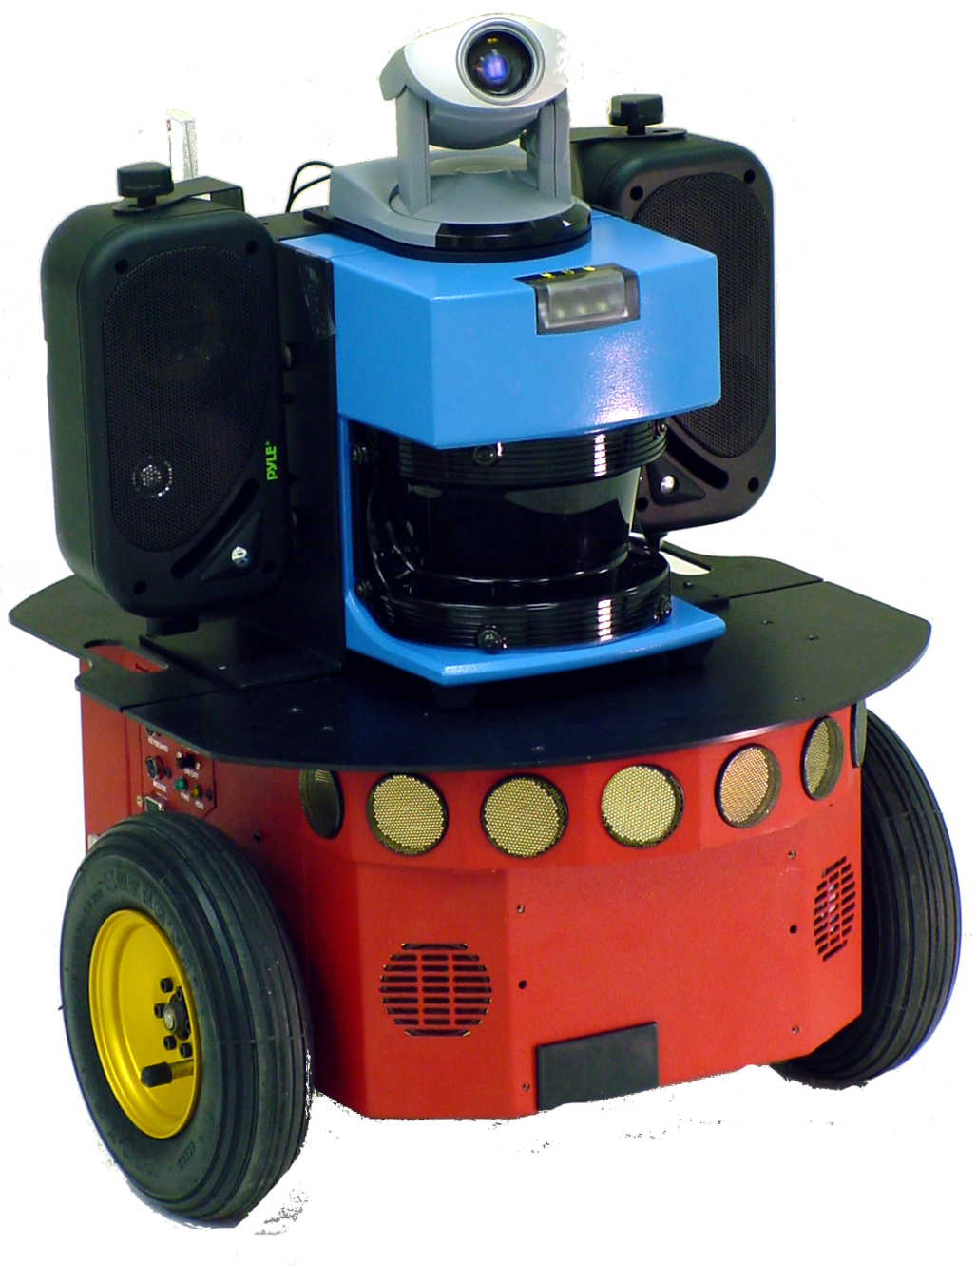

Slide 12
Wheels

Slide 13
Sonar
Wheels

Slide 14
LADAR
Sonar
Wheels

Slide 15
Vision
LADAR
Sonar
Wheels

Slide 16
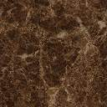

Slide 17
Incompatible Mobility

Slide 18
No Odometry

Slide 19
Failure by Proximity

Slide 20
Failure by Ambient Fluid

Slide 21
Major Challenges
Variant fluids
Reflections, distortions
Dark
Unstructured environment
Loose debris
Variable wall widths
No odometry or dead-reckoning
No GPS
Large chambers
Slip

Slide 22
Related Work
Mapping underground mines [Thrun04]
Large space, able to use range sensors, easy mobility
Pipe inspection [Fukuda89]
evacuated tubes, external sensors operable
Flooded subterranean caves [Gary08]
calibrated sonar, large space
Robot sub under sea ice [Kunz et al 08]
calibrated sonar, large space
Geometric contact detection [Kaneko94], [Grupen, Huber93], [Haidacher02], [Mimura94]
non-mobile, high accuracy, time-consuming
Probing the boundary in an oil well [Mazzini11]
non-mobile, high accuracy, time-consuming
Initial work sensing void space [Everist09]
preliminary work

Slide 23
Approach
Develop algorithmic methods for robotically mapping
in confined environments
proprioceptive sensors only
Use an articulated mobile robot and reconstruct posture
joint sensors, known geometry and a far reach
Use robot posture to identify void space
Sweep the body to build up information
Boundaries are indirectly inferred from mapped void space

Slide 24
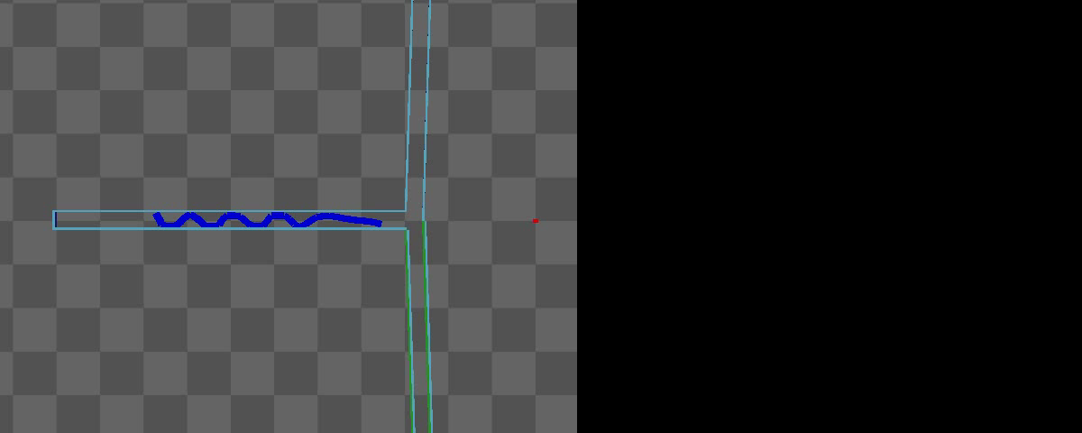

Slide 25
Assumptions
Robot
All external sensors have failed
Only joint angle sensors are available
Dynamically set max torque
Body geometry is known
Environment
Confined
Pipe-like or tubular
Rigid walls
Flat ground, no slopes
Variable width (map and navigate)
Constant width (map, navigate, w/ junctions)
Simulation Only
Rigid Body Physics Engine
Bullet Physics: https://github.com/bulletphysics/

Slide 26
Evaluation
Success metric:
Can the robot generate a map of the environment?
Can the map be used by other robots for navigation?
Task:
Use the robot the explore and generate the map
Give the map to a new robot, direct it to a location on the map
Does it reach the target location?

Slide 27
Search for Best Map
Junctions
Build Maps
Control
Robot Frame
Features
Sensing

Slide 28
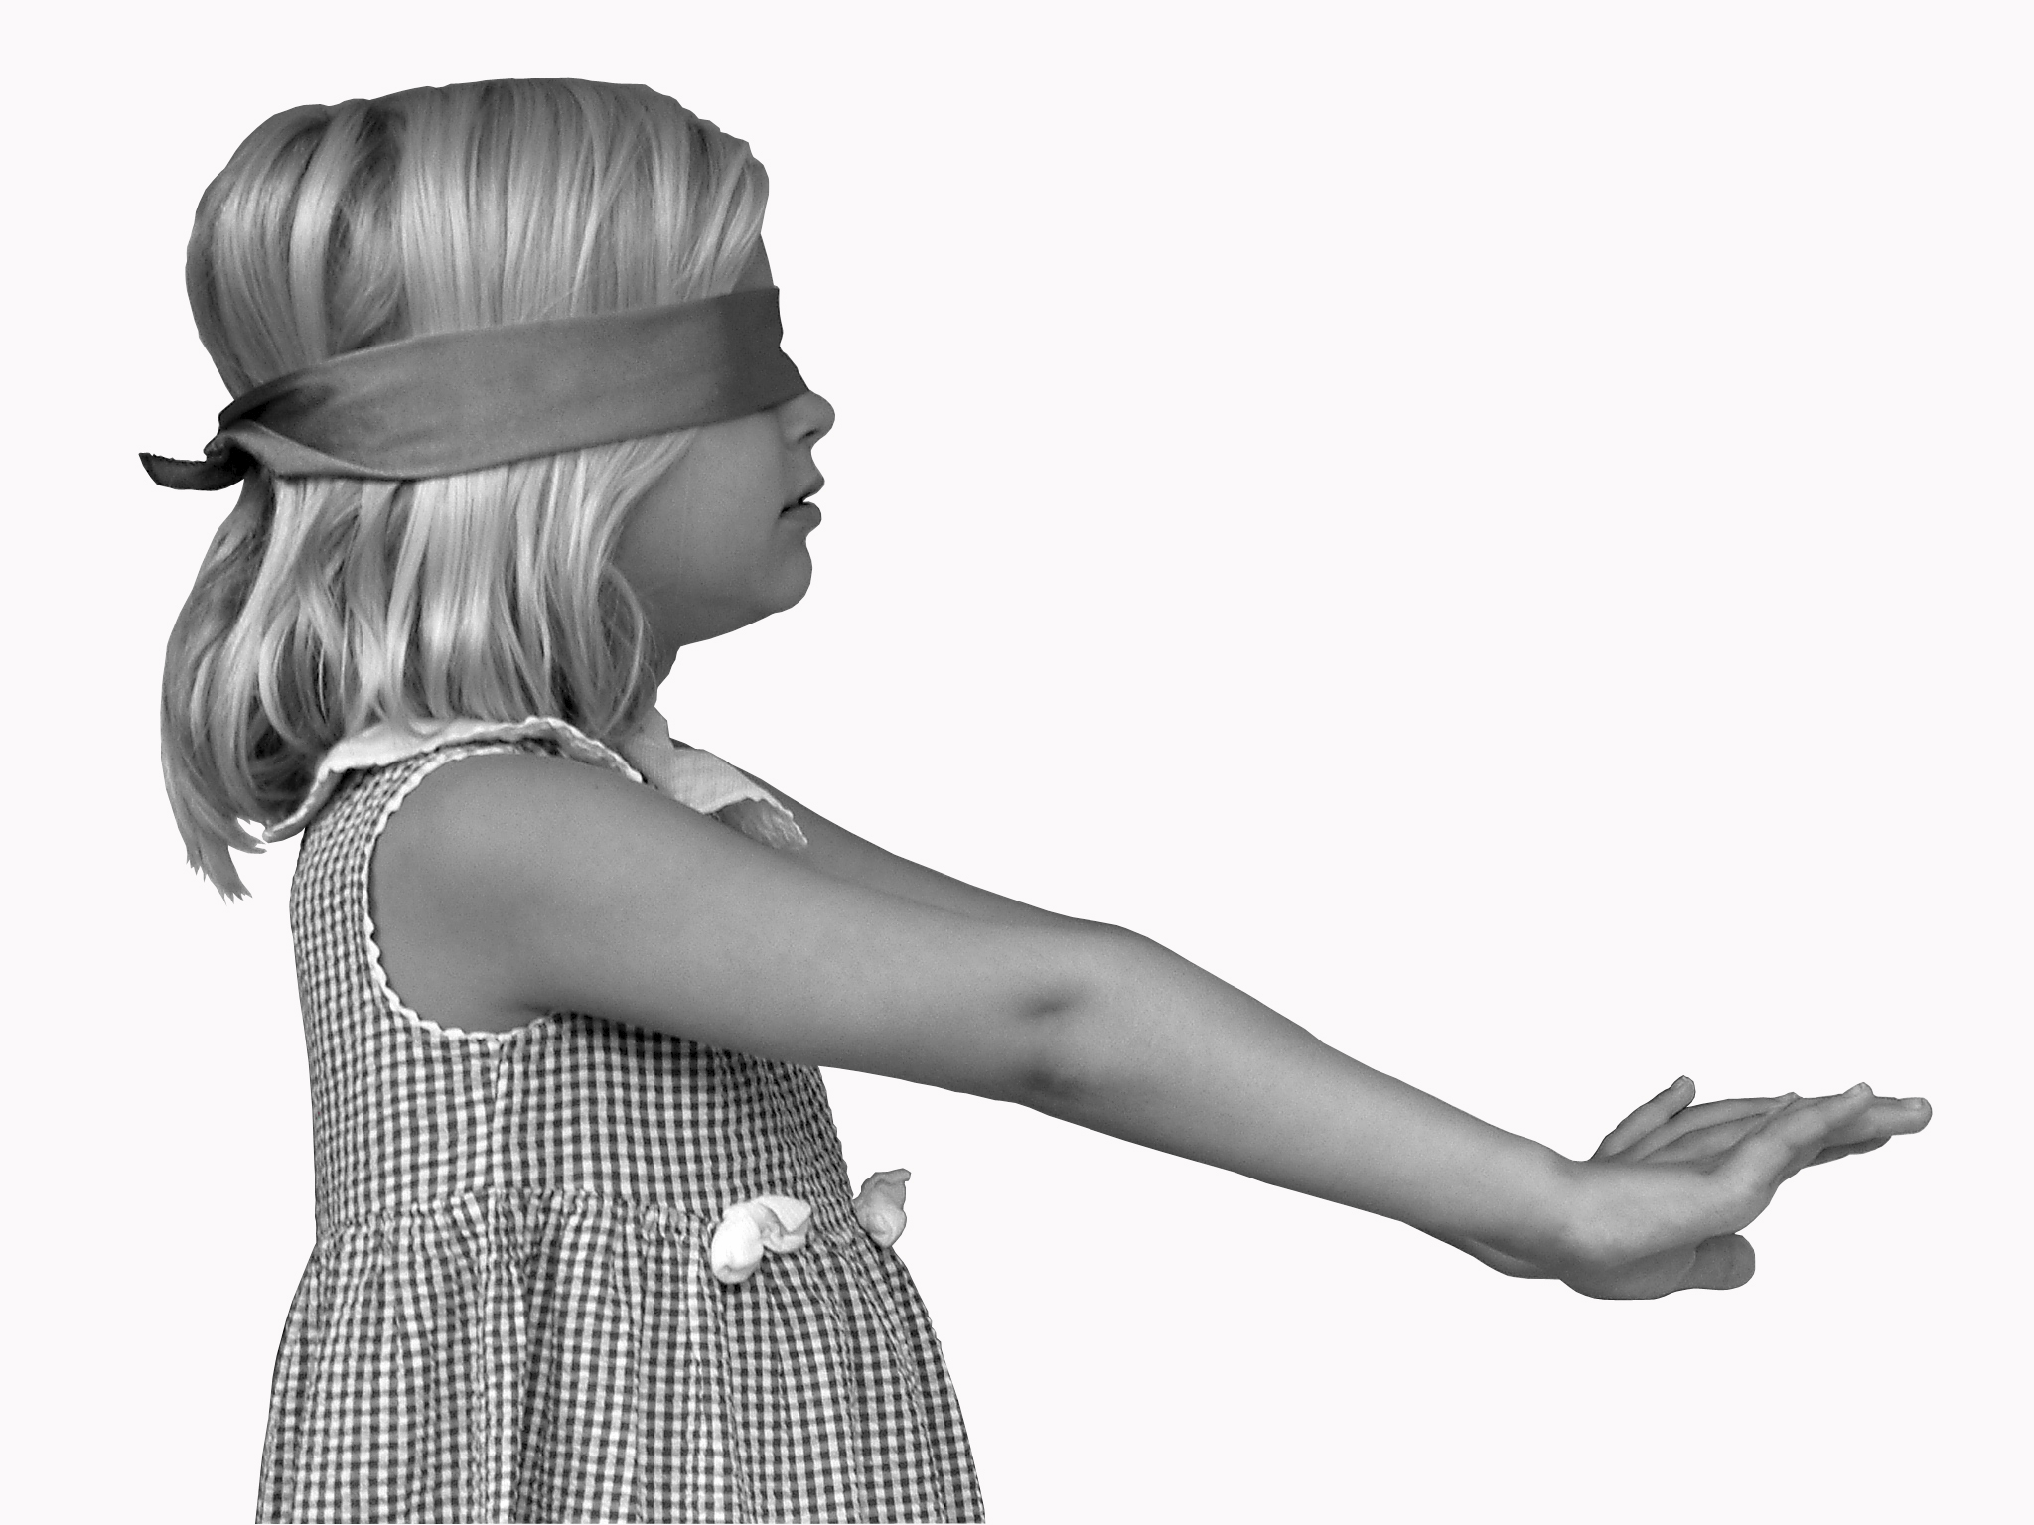
External Sensor Failure

Slide 29
Types of Sensing
 | Biology | Robotics
Exteroception | sight, hearing, touch, taste, smell | camera, sonar, LIDAR, touch sensor
Interoception | hunger, hot, cold, thirst, pain, etc. | battery sensor, temperature
Proprioception | relative position of neighboring parts of the body, strength of effort | joint sensor, strain sensor, and current sensor, accelerometer, gyros, INS

Slide 30
Sensing with Proprioception
Existing methods for proprioceptive object detection
From robot manipulation literature (fixed base)
Contact Detection
infer contact points from geometry and motion
Finger Probing
poke the object with a “finger”

Slide 31
Sensing Void Space
Problem: how sense environment with proprioception?
Solution: identify void space by sweeping the robot’s body
Infer the obstacles from shape of void space
Not where they are, but where they’re not
Extract maximum information from minimal sensors

Slide 32
Proprioceptive Spatial Awareness
Use movement and body geometry to build awareness of space
Plot into a local map representing void space

Slide 33
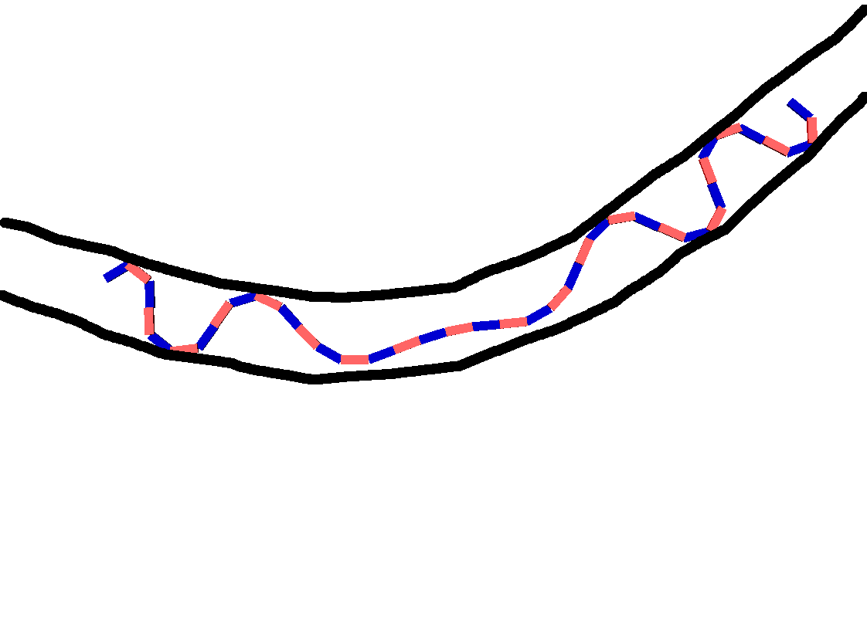
Anchor Points
Anchor Points

Slide 34
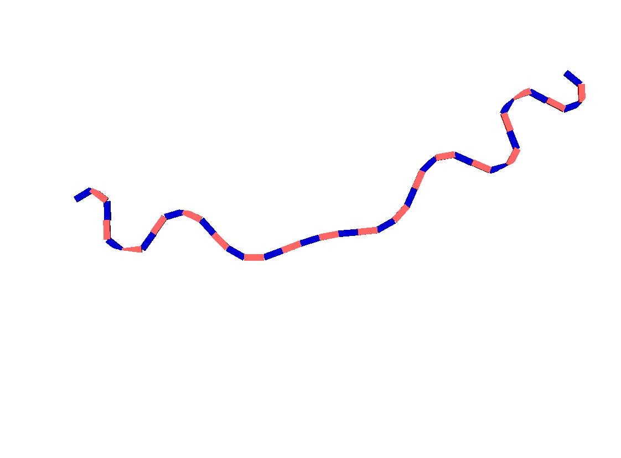

Slide 35
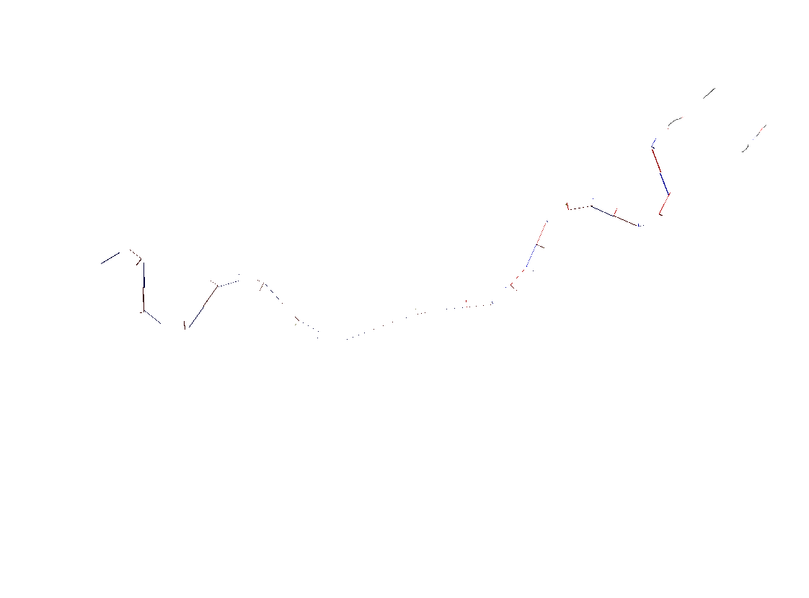

Slide 36
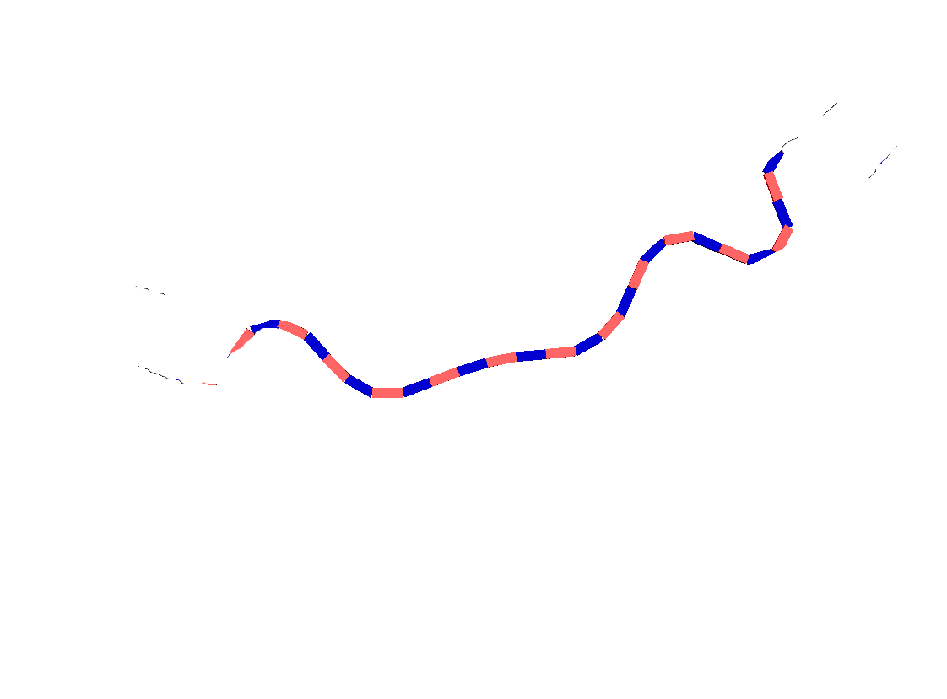

Slide 37
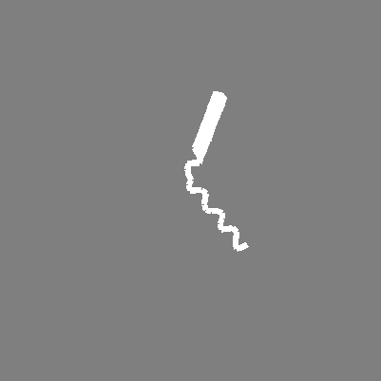

Proprioceptive Sensing
The posture image I_{t} , is captured at pose X_{t} by sweeping the body in one direction and anchoring in the other direction.

Slide 38
Search for Best Map
Junctions
Build Maps
Control
Robot Frame
Features
Sensing

Slide 39
Environmental Landmarks and Features
Features to build the map
Boundary features
Obstacles/walls
Corners
Void space features
Shape features
Spatial features

Slide 40
Shape Features
Shape of the sensed void space in local environment should give us information.
How can we extract this information and represent it in an useful way?

Slide 41
Shape Feature
Spatial curve c_{t} = scurve(I_{t}) where I_{t} is posture image
Smoothed version gives us a curve representation of the local space

Slide 42
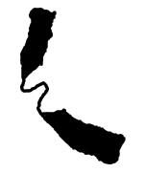
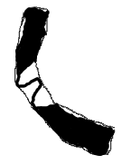
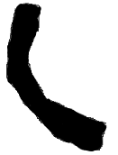
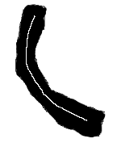
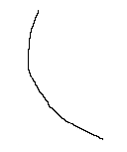
Spatial curve c_{t} from posture image I_{t}
Posture Image I_{t}
c_{t} = scurve(I_{t})

Slide 43
Spatial Features
3 different spatial features from posture images
blooms
arches
bends
Landmarks usually indicate junctions or gaps in space
Can match landmarks together to improve the map

Slide 44
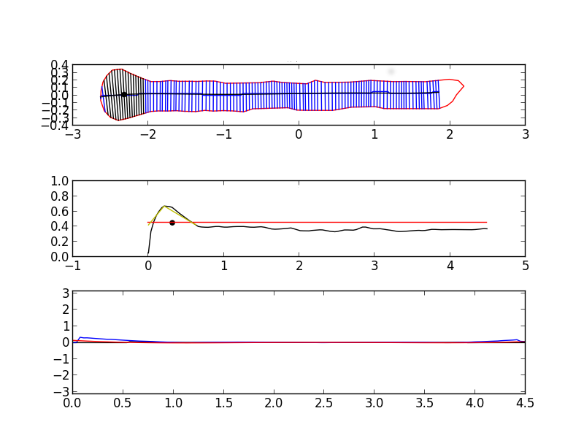
Blooms: swelling at the tip (assumes constant width)
Width
Curve Length
Tangent
Angle
Curve Length

Slide 45
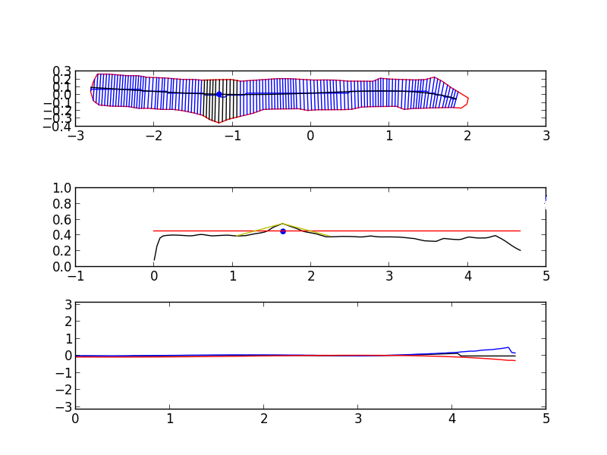
Arches: internal swelling, “arched” anchors (assumes constant width)
Width
Curve Length
Tangent
Angle
Curve Length

Slide 46
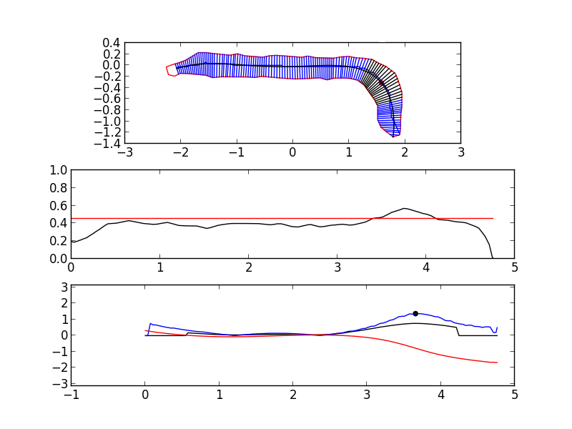
Bends: sudden turn of spatial curve, crest is the bend point (permits dynamic width)
Width
Curve Length
Tangent
Angle
Curve Length

Slide 47
Search for Best Map
Junctions
Build Maps
Control
Robot Frame
Features
Sensing

Slide 48
Robot Frame
Articulated robot has no high-inertia center of mass to serve as its coordinate frame.
Individual segments are rotating and undulating
Need method to determine direction of snake robot.
Information not provided by individual body segments

Slide 49
Posture Curve
Posture curve generated by smoothed B-spline with joint locations as inputs
Generates the posture frame for local coordinate system
Different from spatial curve which represents local sensed environment

Slide 50
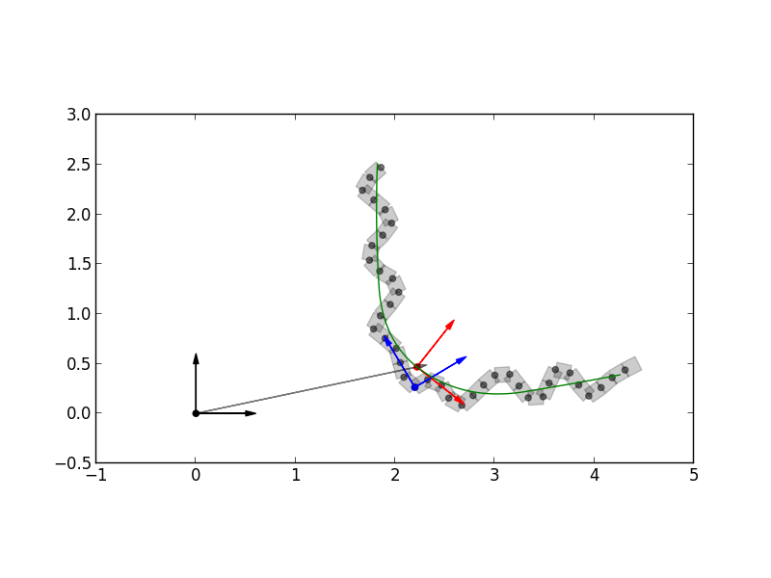
Posture Curve
Pose of Frame P in Frame G
X^{G} = (x, y, θ)
Posture Frame P
Body Frame B
y
x
Global Frame G
θ
Initialize X₁ = (0, 0, 0)

Slide 51
Search for Best Map
Junctions
Build Maps
Control
Robot Frame
Features
Sensing

Slide 52
Control and Locomotion
Simulated robot control
algorithms tuned for simulated environment
Adaptive anchoring
making strong and stable anchors to the walls with verification
Concertina locomotion
Practical heuristic for sensor-deprived environment
Snake control, backbone curves (Chirikjian)
inverse kinematics by fitting to a curve
Segmented behaviors
sections of linkage controlled by different behaviors
Smooth motion and compliance
interpolated and compliant motion
Stability detection
checking for slip and transient disturbances

Slide 53
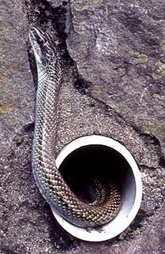
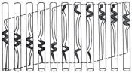
Concertina Motion
Gans 1980

Slide 54
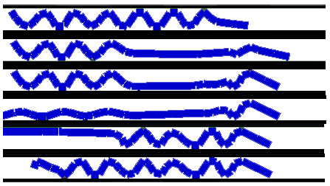
Gait Stages
Rest-State
Front-Extend
Front-Anchor
Back-Extend
Back-Anchor
Rest-State

Slide 55
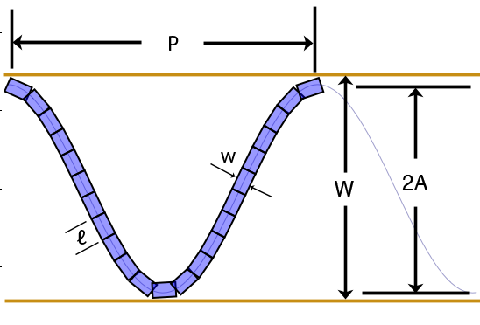

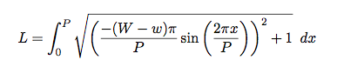
Anchoring
Single anchor case
2 anchors plus extension require
for W->∞, L = 2(W-w),
so for concertina gait
L = 4(W-w) + e
where e is extension length

Slide 56
Search for Best Map
Junctions
Build Maps
Control
Robot Frame
Features
Sensing

Slide 57
Inputs
Given experience:
I₁ I₂ A₁ I₃ I₄ A₃ I₅ I₆ A₅ .....
Posture Image
Solve for:
X₁ X₂ X₃ X₄ ....
Locomotion Step
Pose

Slide 58
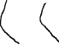
Initial Condition for Building the Map
Poses X₁ =(0,0,0) and X₂ = ?
Forward sweep I₁ and backward sweep I₂
Spatial curves C₁ = scurve(I₁), C₂ = scurve(I₂)
I₁
I₂
C₁
C₂

Slide 59
4 Methods
Naive Method
Axis Method
Junction Method
Search Method

Slide 60
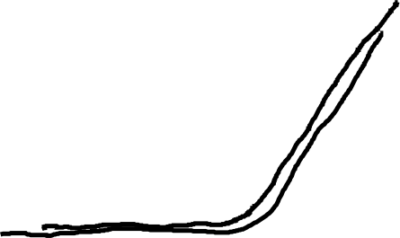
In-Place Constraint
overlap spatial curves of X₁ and X₂
X₂ = overlap(X₁, C₁, C₂, d=0)
Generalized Iterative Closest Point (genICP) algorithm to fit

Slide 61
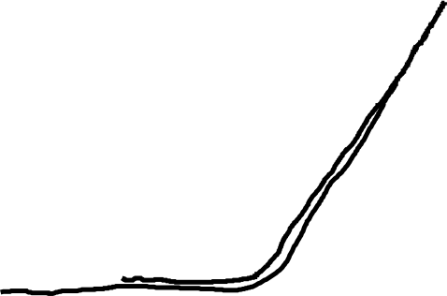
Step Constraint
X₃ and X₄ are new poses after locomotion step
Solve for new location
X₃ = overlap(X₁, C₁, C₃, d=δ) where δ = 0.5
Constant δ is estimated distance traveled giving initial guess

Slide 62
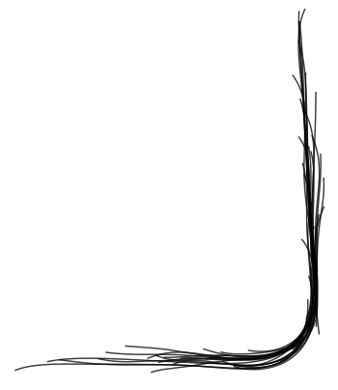

Slide 63
Shortcoming of Naive Method
Only consistent with last pose
history is ignored
Poses can flair off path
Backtracking
does not stay on past path

Slide 64
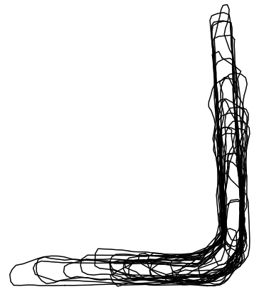
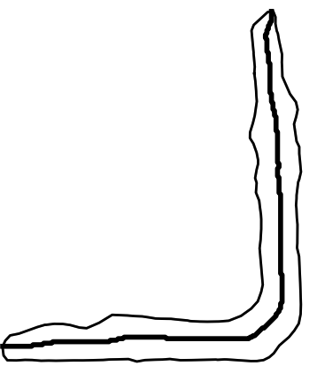
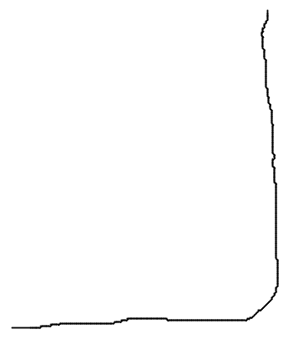
Axis Method
Compute union of past poses’ posture images
Compute medial axis of the map
New pose must constrain to existing axis

Slide 65
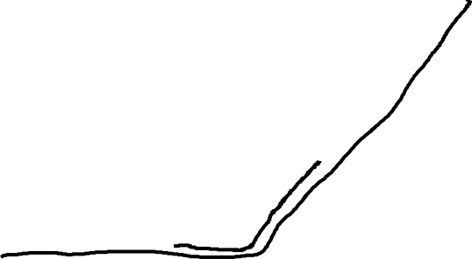
Steps of Axis Method
apply step constraint to make initial estimated pose
apply axis constraint around estimated pose

Slide 66
Search for Best Map
Junctions
Build Maps
Control
Robot Frame
Features
Sensing

Slide 67
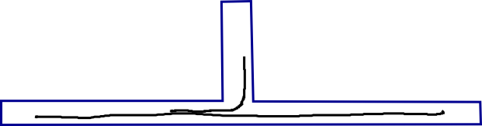
Problem
Axis constraint mapping does not work in environments with junctions
Does not correctly fit to axis with ICP

Slide 68
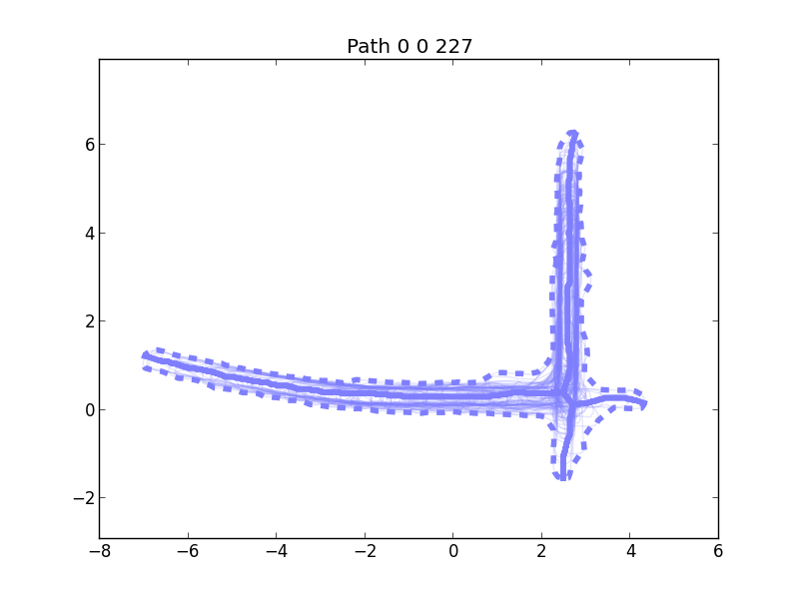
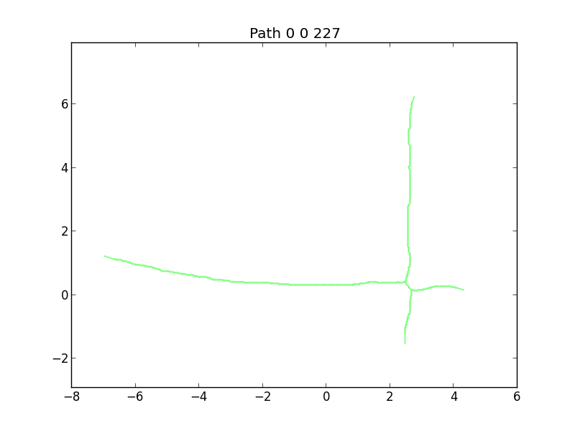
Skeleton
The medial axis of the union of posture images with pose information

Slide 69
Branching
Look for cases where spatial curve branches off the existing skeleton
Create a new skeleton

Slide 70
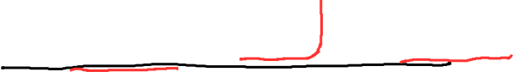
Define Curve Events
Divergent
Contained
Extending

Slide 71
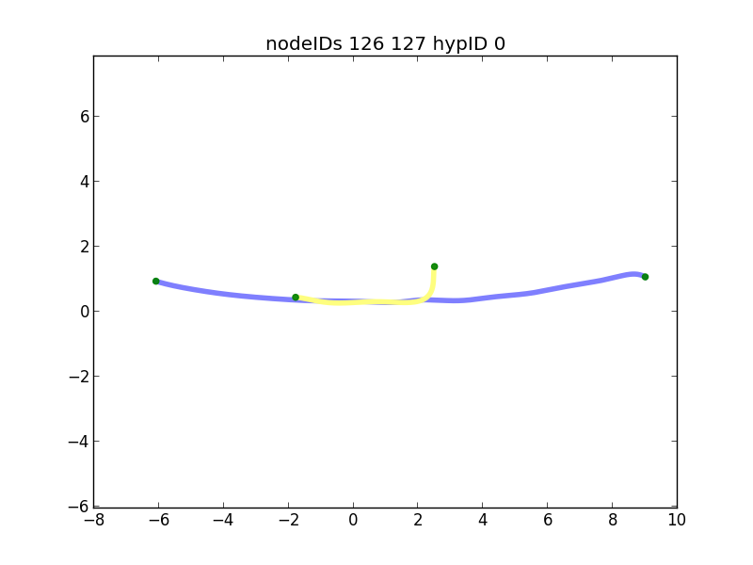

Slide 72
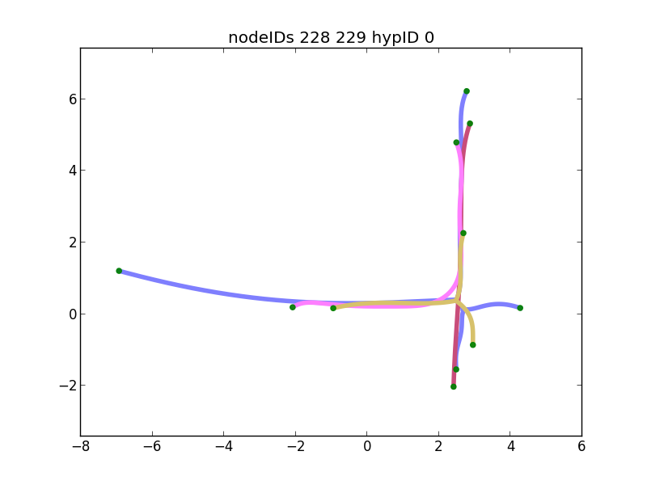

Slide 73
Localization on Skeletons (Junction Method)
No longer curve-to-curve ICP
ICP to multiple skeletons
Multiple configurations
Create splices on sets of overlapping skeletons
Defined by a path between any two skeleton terminals

Slide 74
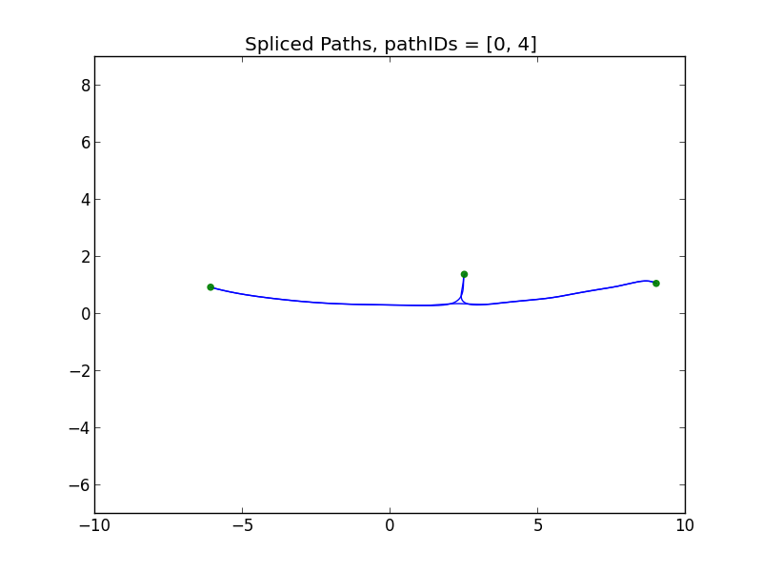

Slide 75
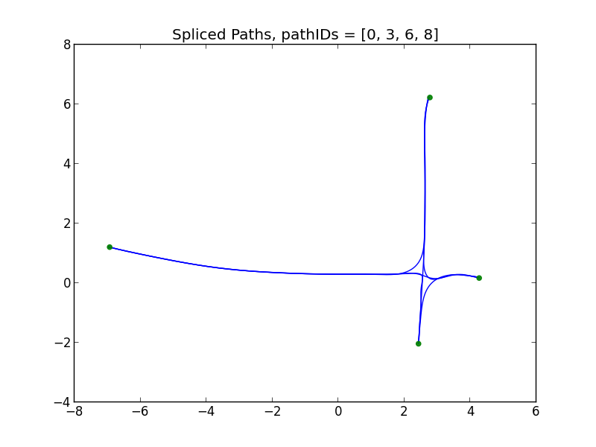

Slide 76
Fit a New Pose onto Past Skeletons (Junction Method)
Collect set of skeleton terminals
Disregard terminals that are similar or subsumed by another skeleton
Collect (n choose 2) paths between each pair of n terminals
Perform ICP on each spliced path
Evaluate and select “best fit” according to some criteria

Slide 77
Search for Best Map
Junctions
Build Maps
Control
Robot Frame
Features
Sensing

Slide 78
Problems
Branching in right location?
New branch, existing branch, or no branch?
Pose in right location?
Leads to a search method

Slide 79
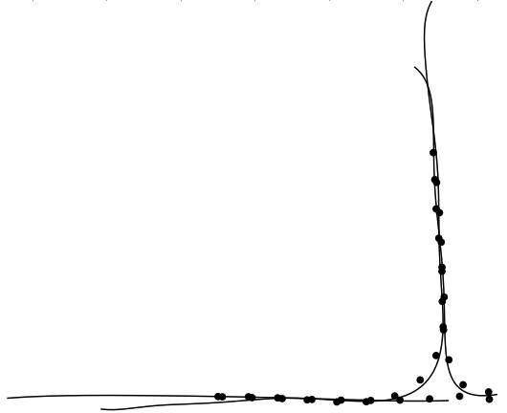
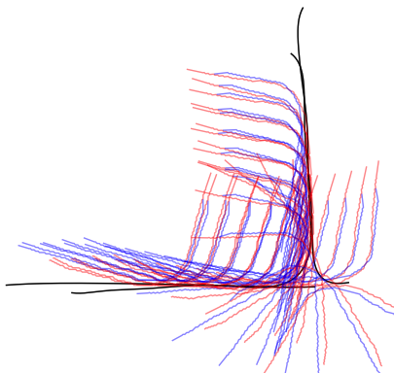
Search Method
Uniformly discretize possible poses on every splice curve
Sample many spatial relations between skeletons
Select best evaluated state as our map

Slide 80
Parameterization
Possible poses of the new posture image X_{t}
Skeleton sets: Grouping of all posture image with pose information S_{k}
Spatial relationship between skeletons, control points b_{k}

Slide 81
Mapping Problem
Actions:
Move commands:
Sensing:
Posture vector: snapshot of joints time t
Posture sequence: series of snapshots from sweep behavior
Posture Images: union of robot’s geometry under posture sequence
Map Parameters:
Poses:
Skeletons:
Control Points:

Slide 82

Spatial Transform of Skeletons
Control point on “parent” skeleton
Reduced to 1D search space

Slide 83
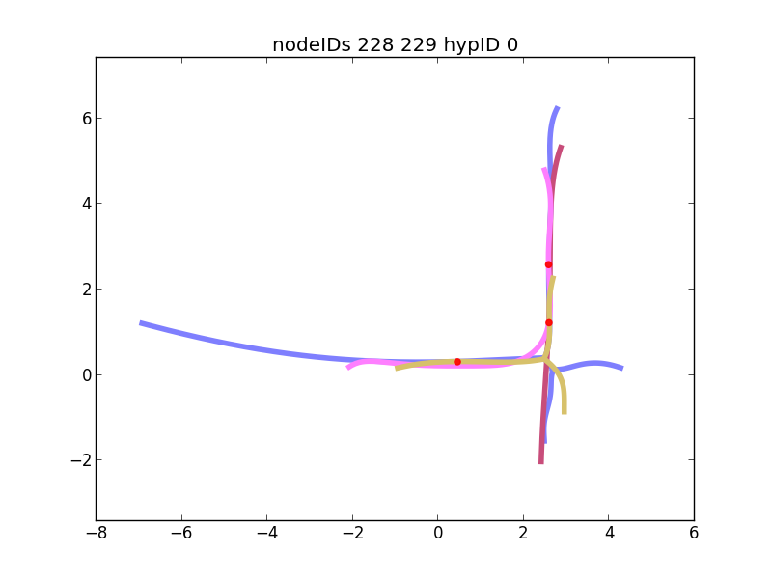

Slide 84
Search Method Steps
Objective: solve best fit for X_{t}, skeletons S_{1:k}, and spatial relation b_{1:k}
Motion Estimation
Add-to-Skeletons
Overlap Skeletons
Localize Pose to Map
Merge Skeletons

Slide 85
Motion Estimation
Select discrete possible poses uniformly along all splices of the set of overlapping skeletons
Evaluate based on consistency F(x)
F(x) = -2*overlapSum0 – 2*overlapSum1 – angDiff0/Pi – angDiff1/Pi + 2*normLandmarkSum
Bias likelihood with Gaussian curve representing motion estimated from last best pose
Select best possible pose, keep all past sampled possible poses

Slide 86
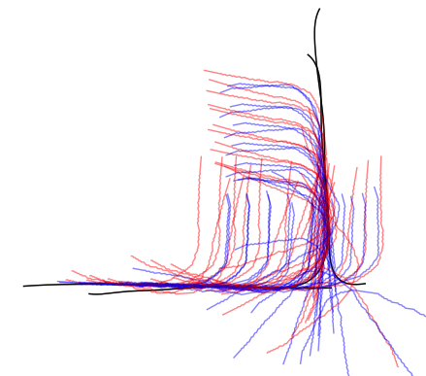
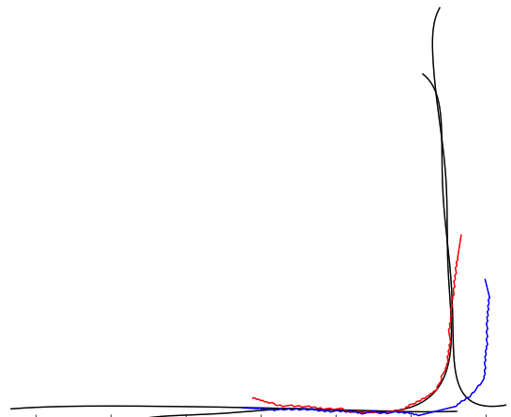

Slide 87
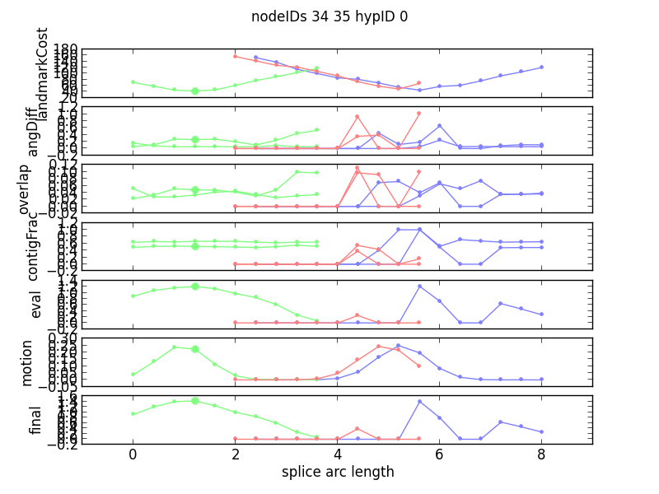

Slide 88
Add to Map
Determine if pose’s spatial curve is diverging
Create new branching skeleton if diverging
Otherwise, add to an existing skeleton

Slide 89
Skeletons Overlapping State
Evaluate all skeleton states
Maximize evaluation function G(b₁₂)
Measures overlap and landmark consistency
G(b₁₂) = normLandmarkCost * normMatchCount

Slide 90
Localization
ICP localize all previous samples across all splices
Select maximum evaluated pose H(x)
H(x) = normLandmarkSum * contigFrac0 * contigFrac1
Correct the map with best fit pose

Slide 91



Slide 92


Slide 93


Merge
Merge skeletons together if they are fully constrained

Slide 94
Experimental Results

Slide 95
Experimental Setup
Bullet Physics: https://github.com/bulletphysics/
Amazon EC2 Cloud
c3.8xlarge provisioned server (32 vCPUs, 60GiB memory)
8 map features * 3 trials each = 24 experiments
time taken = 71 hours
money cost = $74 (out of $1108 spent)

Slide 96
Capabilities
Junction Feature | Forward | Backtracking | Branching | Navigation
60_right | May 2009 | April 2011 | n/a | April 2011
60_left | May 2009 | April 2011 | n/a | April 2011
L_right | May 2009 | April 2011 | n/a | April 2011
L_left | May 2009 | April 2011 | n/a | April 2011
Y | May 2009 | Sep 2011 | August 2012 | August 2012
T_bottom | May 2009 | Sep 2011 | August 2012 | Sep 2014
T_side | May 2009 | Sep 2011 | June 2014 | Sep 2014
cross | May 2009 | Sep 2011 | June 2014 | Sep 2014

Slide 97
Results
Results | 11/18/2014 |  |  | 12/01/2014 |  |  | 01/14/2015
60_right | S | S | S | S | S | S | S | S | S
60_left | S | S | S | S | S | S | S | S | S
L_right |  | S | S | S | S | S | S | S | S
L_left |  |  |  | S | S | S | S | S | S
Y | S | S |  | M | X | X | X | S | S
T_bottom | S |  |  | X | M | X | S | S | X
T_side |  | S |  | M | S | M | S | S | S
cross |  |  |  | M | M | C | S | S | S
S = success
M = map eliminated
X = crash
C = combinatorial explosion

Slide 98













Slide 99













Slide 100


Slide 101


Slide 102


Slide 103


Slide 105
Conclusion

Slide 106
Contributions
Use proprioceptive sensors only to map
Use void space to build a map
Map representation using posture images, poses, and overlapping skeletons
Mobile platform mapping
Articulated robot mapping
Junctions in non-looping environment
Novel evaluation function for this new problem

Slide 107
Conclusion
We developed a method of mapping confined environments when external sensors are not available
We use proprioceptive sensors and the robot’s known geometry
We were able to explore, map and navigate environments with a variety of features in a simulated environment

Slide 108
Future Work
Angular drift
Straight featureless pipes
Environments with loops
3D environments
Physical robots
Different type’s of robots
Loose clutter in environment
Switch off between external and proprioceptive
Multi-junction environments
Large-scale environments

Slide 109
End

Slide 110
Mapping Problem (backup)
Actions:
Move commands:
Sensing:
Posture vector:
Posture sequence:
Posture Images:
Map Parameters:
Poses:

